Slide 1
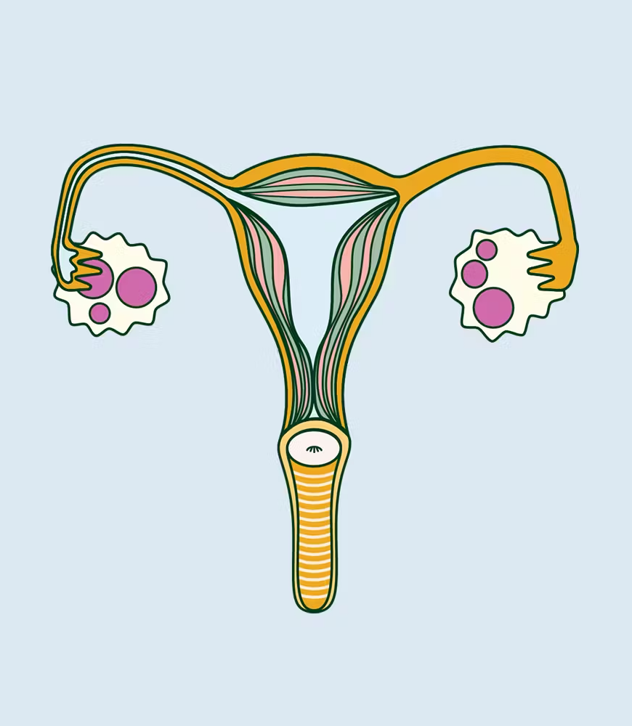
Using Machine Learning Algorithms to Predict the likelihood of Polycystic Ovarian Syndrome based on Demographic, Clinical and Lifestyle Factors
CUNY SPS Data 698 - Analytics Masters Research Project
Leticia Salazar
Notes:
Hello, my name is Leticia Salazar and I will be presenting my capstone project for Data 698 – Using Machine Learning Algorithms to Predict the likelihood of Polycystic Ovarian Syndrome based on Demographic, Clinical and Lifestyle Factors.

Slide 2
Agenda
1.1 The Problem
1.2 Objectives
1.3 Literature
Review
1. Introduction
3. Methodology
4. Assumptions
2. The Dataset
5. Experimentation and Results
6. Conclusion
Presentation Title
Notes:
For my presentation I will review the problem I tried to solve, how I went about solving it, my assumptions before starting to build my models, my finding and conclusion.

Slide 3
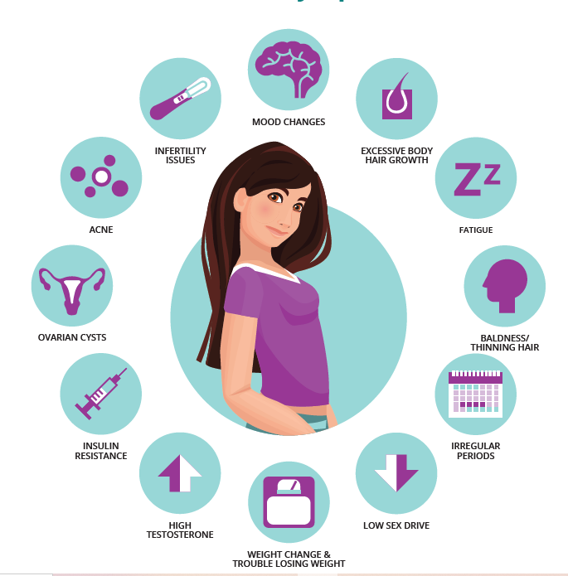
Introduction:
Polycystic Ovarian Syndrome (PCOS) is an endocrine disorder affecting women of reproductive age worldwide.
Despite ongoing research efforts, unraveling the exact cause and identifying the most effective management approaches for PCOS remains an evolving field of investigation within modern medicine.
Notes:
Polycystic Ovarian Syndrome or (PCOS) for short stands as a prevalent endocrine disorder affecting women of reproductive age worldwide, presenting a confluence of hormonal imbalances, reproductive irregularities, and potential metabolic complications. Characterized by irregular menstrual cycles, hyperandrogenism, and polycystic ovaries, PCOS poses multifaceted challenges that extend beyond reproductive health, encompassing metabolic disturbances and psychological implications.
The clinical landscape of PCOS often requires a comprehensive, multidisciplinary approach, incorporating lifestyle modifications, pharmacological interventions, and personalized treatments to address symptoms and reduce associated health risks. Despite ongoing research efforts, unraveling the exact cause and identifying the most effective management approaches for PCOS remains an evolving field of investigation within modern medicine.

Slide 4

Problem:
Approximately 17.5 million women report suffering from PCOS.
Early identification of risk factors associated with PCOS can assist in timely interventions and lifestyle adjustments.
Employing predictive models can play a pivotal role in increasing awareness regarding PCOS risk factors and preventive measures.
Develop machine learning models that predicts the probability or risk of an individual having or developing PCOS .
Notes:
Determining the precise global count of women affected by PCOS poses challenges due to many cases remaining undiagnosed. However, the World Health Organization estimates that approximately 3.4% of women are affected. While this percentage might seem relatively small, considering that women constitute 49.7% of today’s population nearly 13% of them fall within the reproductive age bracket. This data suggests that approximately 17.5 million women report suffering from PCOS.
It’s important to note that the prevalence of PCOS varies by region and ethnic groups, with some studies suggesting higher rates of PCOS in certain populations. Early identification of risk factors associated with PCOS can assist in timely interventions and lifestyle adjustments. Tailoring suggestions or treatments based on individualized risk profiles has the potential to enhance patient outcomes. Employing predictive models can play a pivotal role in increasing awareness regarding PCOS risk factors and preventive measures. However, limitations may exist in accessing comprehensive and varied datasets containing accurate demographic, clinical, and lifestyle data. Addressing these challenges involves the development of a robust predictive models using machine learning techniques. Such efforts holds the promise of significantly contributing to the identification of individuals at risk of PCOS, thereby enabling early interventions and guiding personalized healthcare strategies for improved management of the condition.

Slide 5

Objectives:
Construct 6 machine learning algorithms
Decision Tree, Random Forest, Gradient Boosting Machines, Support Vector Machines, Neural Networks and k-Nearest Neighbors
Notes:
This research seeks to explore current studies related to PCOS diagnosis by acquiring datasets from Kaggle.com and assessing the eﬀiciency of diverse machine learning algorithms, encompassing Decision Tree, Random Forest, Gradient Boosting Machines, Support Vector Machines, Neural Networks, and K-Nearest Neighbors.

Slide 6
Objectives:
I anticipate answering the following questions with my data:
Are there commonalities women with and without PCOS have that can be easily dismissed as normal?
Are there differences for women of different race/ethnic background when it comes to having PCOS? What about women without PCOS?
What is the likelihood of a woman developing PCOS based on her age, ethnicity, and BMI history?
Can we predict the risk of insulin resistance, diabetes, and cardiovascular disease in women with PCOS based on their medical history, hormone levels, and lifestyle factors?
Can we predict the likelihood of successful pregnancy outcomes in women with PCOS based on their age, weight, hormone levels, and treatment history?
Can we predict the long-term health outcomes and quality of life of women with PCOS based on their age, lifestyle factors, hormone levels, and treatment history?
Notes:
I also anticipate answering the following questions with my data:
Are there commonalities women with and without PCOS have that can be easily dismissed as normal?
Are there differences for women of different race/ethnic background when it comes to having PCOS? What about women without PCOS?
What is the likelihood of a woman developing PCOS based on her age, ethnicity, and BMI history?
Can we predict the risk of insulin resistance, diabetes, and cardiovascular disease in women with PCOS based on their medical history, hormone levels, and lifestyle factors?
Can we predict the likelihood of successful pregnancy outcomes in women with PCOS based on their age, weight, hormone levels, and treatment history?
Can we predict the long-term health outcomes and quality of life of women with PCOS based on their age, lifestyle factors, hormone levels, and treatment history?

Slide 7

Literature Review:
Common Focus Area: Multiple studies emphasize the use of machine learning algorithms, such as Naïve Bayes, Decision Trees, Artificial Neural Networks, Support Vector Machines, and ensemble methods, for PCOS diagnosis.
Achievements: The findings revealed that CNN models performed best, achieving accuracies ranging from 85% to 98.12% in different studies [Anda, 2022].
Recommendations: Some studies may suffer from limited sample sizes or datasets, impacting the generalizability of findings. Larger and more diverse datasets are recommended for robust model development and validation [Goodarzi, 2015].
Notes:
My emphasis was to discover literature reviews that validate the relevance of the dataset utilized alongside the chosen machine learning algorithms. In pursuit of this goal, I’ve come across various articles that refer to the dataset from Kaggle.com. The literature reviews collectively delve into various aspects of PCOS, employing diverse methodologies and approaches for diagnosis, classification, understanding clinical manifestations, and proposing potential treatments.
Some key takeaways:
Common Focus Areas: Multiple studies emphasize the use of machine learning algorithms, such as Naïve Bays, Decision Trees, Artificial Neural Networks, and Support Vector Machines for PCOS diagnosis. They explore the accuracy and predictive power of these models using diverse datasets, including clinical, lifestyle, and physiological parameters. Investigations into clinical parameters and biometric measures aim to identify potential predictors or indicators of PCOS, such as hormonal imbalances, insulin resistance, metabolic traits, obesity, and associated risks like infertility and cardiovascular issues. Studies examine the diverse clinical presentations and phenotypic variations within PCOS, shedding light on how different subgroups may manifest the syndrome and respond to various treatments.
Achievements: The findings revealed that CNN models performed best, achieving accuracies ranging from 85% to 98.12% in different studies. These models effectively utilize diverse datasets, ranging from ultrasound images to clinical parameters. Research has identified several potential predictive factors for PCOS, including hormonal markers, lifestyle attributes, and metabolic indicators, offering insights into early detection and tailored treatment strategies. The study done by Aggarwal, S., & Pandey, K. used supervised learning algorithms (like random forest, gradient boosting) to assess performance metrics, indicating that these crucial features offer high accuracy in identifying PCOS. Unsupervised learning (K-means clustering) corroborates these findings, suggesting that these key features are pivotal for PCOS analysis. In another study, uses machine learning to screen PCOS patients based on non-invasive parameters. It employed various algorithms like SVM, Decision Trees, Random Forest, etc., for classification, finding that Random Forest achieved the highest accuracy of 93.25%. Overall, studies evaluating PCOS awareness among women have highlighted the importance of education and awareness campaigns in enhancing understanding and facilitating early diagnosis.
Advantages: Machine learning algorithms offer promising accuracy rates, particularly CNNs and ensemble models, in diagnosing PCOS using various non-invasive parameters. Understanding phenotypic variations aids in tailoring treatments based on specific subgroups, potentially improving patient outcomes and management. Efforts toward identifying early markers or predictive factors can facilitate early intervention and lifestyle modifications, mitigating long-term health risks associated with PCOS.
Drawbacks and Recommendations: Some studies may suffer from limited sample sizes or datasets, impacting the generalizability of findings. Larger and more diverse datasets are recommended for robust model development and validation. While certain machine learning models showcase high accuracy, the variability in dataset characteristics and preprocessing methods could influence their effective- ness across different populations or settings. The multifaceted nature of PCOS, influenced by both genetic and environmental factors, presents challenges in pinpointing a singular cause or standard diagnostic criteria.
The collective body of literature reviews signifies advancements in PCOS diagnosis, understanding clinical manifestations, and potential avenues for tailored treatments. The use of machine learning models, especially those employing CNNs and ensemble methods, showcases significant promise in accurate PCOS diagnosis based on non-invasive parameters. However, further research is necessary, emphasizing larger and more diverse datasets, refined models, and a multidisciplinary approach to fully comprehend the complexity of PCOS and enhance diagnostic and treatment strategies.

Slide 8




A little more about our data …
Contains
Missing in action
541 observations and 48 variables
Few variables need values to be computed
Gathered from
Prep Work
Kaggle.com
Containing info from Kerala, India
No missing variables at first until fully processed
Notes:
Our data was gathered from Kaggle.com and consisted of 545 records and 13 variables. Once we started exploring our data we found that there were no missing values although it was later found that there indeed were a few. These values had to to be computed but no other preparation work needed.

Slide 9
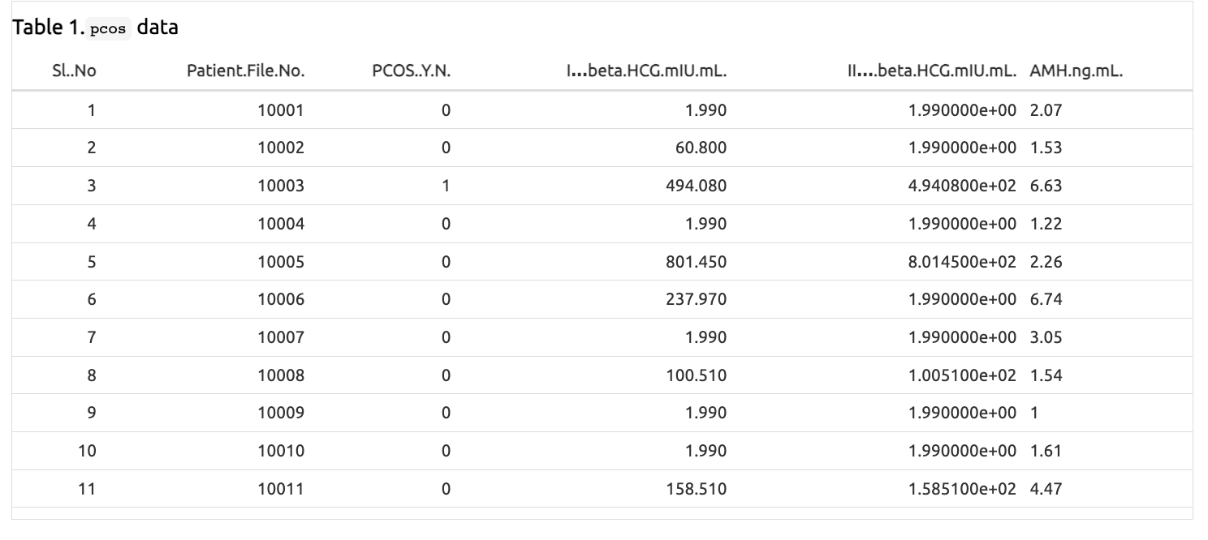
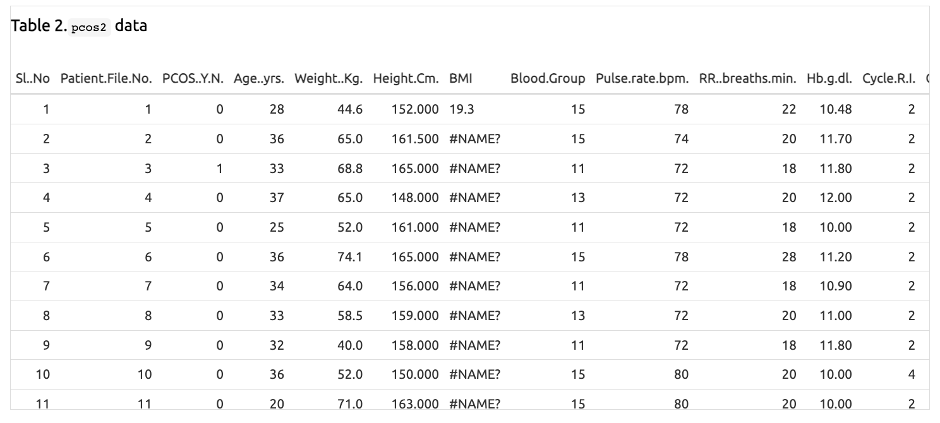
The Data:
Notes:
The Polycystic ovary syndrome (PCOS) dataset, is comprised of two csv files labeled PCOS_data_without_infertility and PCOS_infertility. In total, these files encompass 48 variables and 541 data entries all collected from 10 different hospitals across Kerala, India. The dataset contains all physical and clinical parameters to determine PCOS and infertility related issues. Detail of these variables are seen in my GitHub account linked at the end of my repsentation.
Units used range from imperial to metric system of measurement
For Yes | No questions
– Yes = 1
– No = 0

Slide 10
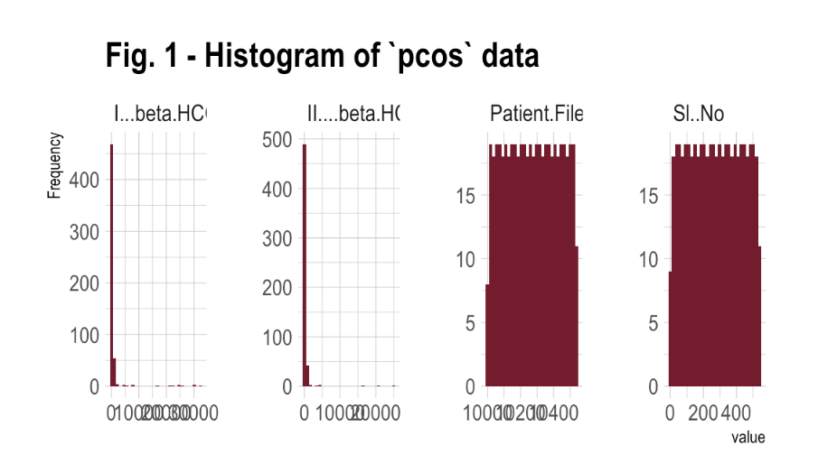
Plots:
Notes:
Upon analyzing the variable distribution, my initial observation indicates that the variables follow a right-skewed distribution. Although the SI..No variable exhibits a unimodal distribution, it lacks significance and will be eliminated upon merging both datasets.

Slide 11
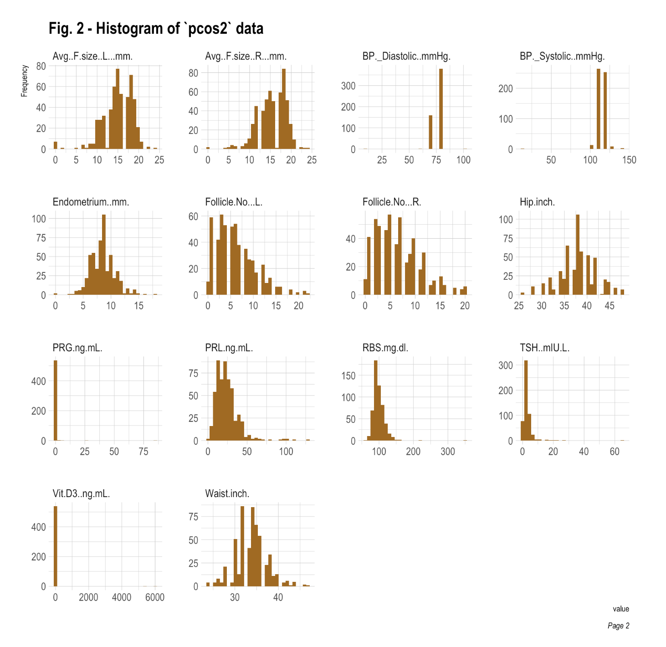
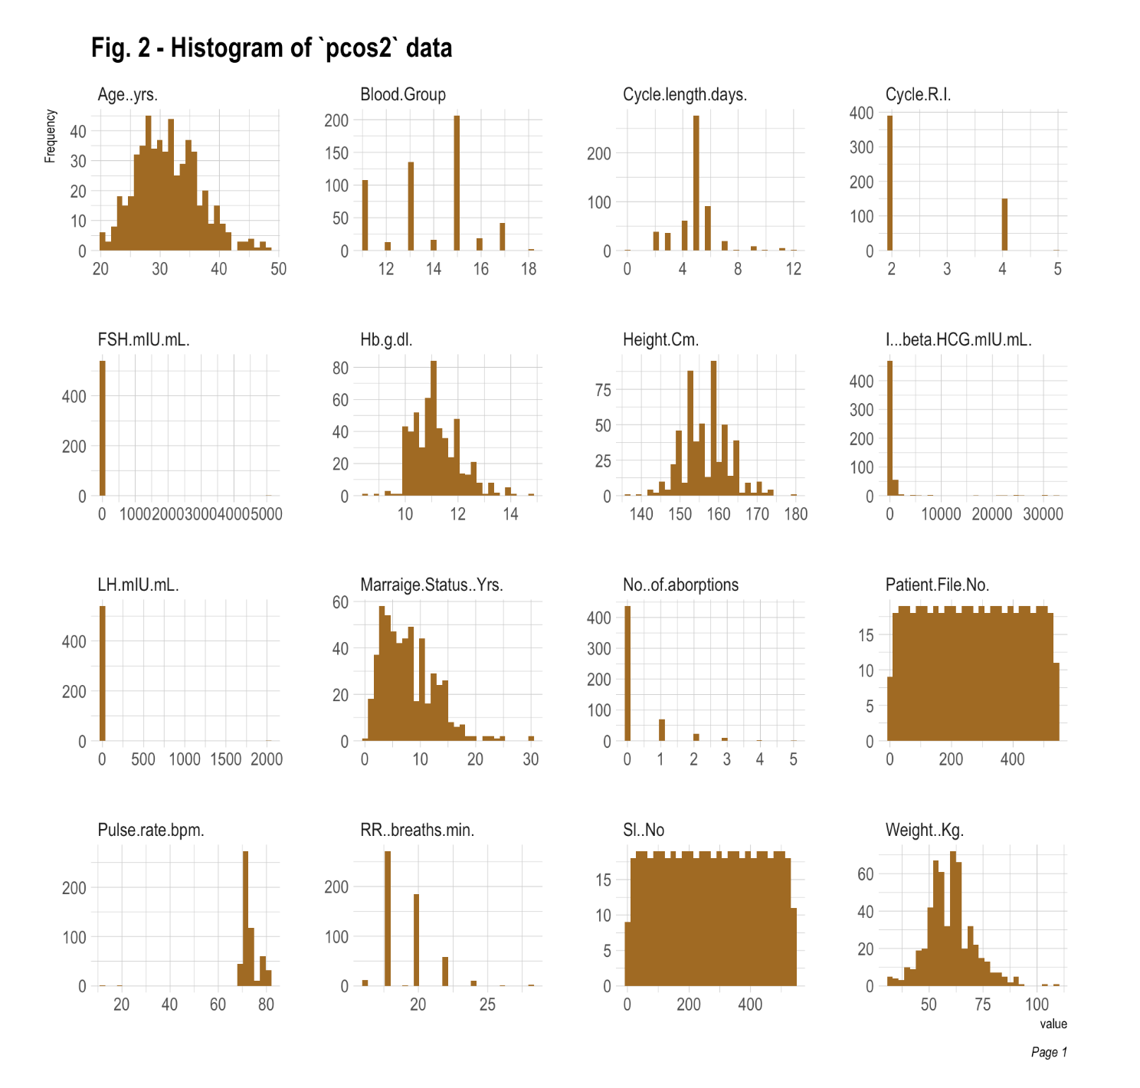
Plots continuation …
Notes:
The second dataset had a small distinct pattern where some of variables were right or left skewed. Similar to the first dataset, SI..No and Patient.File.No. has a unimodel distribution but plays no significant role in my analysis.

Slide 12
Methodology:
Examined
Evaluation and Results
Review each variable within the model and visualize
Retrieve the accuracy of each model
Substantial data preparation for both datasets
Assessed
Model Building
Preparation
541 records containing physical and clinical parameters to determine PCOS
Split the data 75:25
Create two sets of datasets: whole data and then 6 highest contributing variables
Standardizing datasets to numeric
Addressing missing data
Renaming and removing columns
Notes:
Upon importing the data into R, I conducted an assessment to gain a comprehensive understanding of the dataset. The exploration revealed a necessity for substantial data preparation before commencing model construction. Utilizing the skimr library, I generated concise summaries for both datasets, which indicated the presence of character and numeric column types without any missing values. Employing the Data Explorer library, histograms were created to examine the distribution of variables in both datasets. However, these distributions did not display any discernible patterns or distinct shapes.
The data preparation phase involved standardizing the pcos and pcos2 datasets as numeric due to variations in variable classes. While confirming the absence of missing data, it was identified that pcos2 contained a few variables with missing values. Upon obtaining a comprehensive overview of both datasets, the procedure involved eliminating unnecessary columns, renaming columns for enhanced readability, and merging the datasets. Additionally, transformations were applied, converting Height from centimeters to meters, Hip and Waist from inches to centimeters. Subsequently, missing values in columns such as BMI, Waist_Hip_Ratio, and FSH_LH were computed and replaced. For Married_yrs, AMH_ngmL, and Fast_food, the missing values were substituted with the median values, as these replacements did not significantly impact the data distribution. Detecting outliers was crucial and accomplished through boxplots for visual representation. Despite their presence, I chose to retain these outliers, acknowledging their importance in representing natural variations within the population. Additional visualizations were created to visualize trends within the refined pcos_cleaned dataset.
Building the models involved the development of six distinct machine learning algorithms: Decision Trees, Random Forest, Gradient Boost Machines, Support Vector Machines, Neural Networks, and k-Nearest Neigh- bor. I initiate by dividing the dataset into training and validation subsets tailored for machine learning mod- els. The training subset is utilized for model training, while the validation subset assesses its performance. Employing a 75:25 ratio strikes a balance, ensuring adequate data for effective model training and a sizable validation set for robust evaluation.
For each algorithm, the following procedures were executed:
Establish a cross-validation configuration, employing the PCOS variable as the target against the en- tire dataset. The split data designated train and valid labeled the training and testing subsets, respectively. Additionally, another cross-validation setup centered on the PCOS target variable, uti- lizing pivotal contributing variables: Follicle_NoL, Follicle_NoR, Hair_growth, Skin_darkening, and Weight_gain.
After the model creation using the train dataset, predictions were generated for the model utilizing the valid data. The output encompassed a confusion matrix and associated statistics aﬀirming the predictive output for the target variable (PCOS). This also included metrics providing insights into the model’s eﬀicacy in classifying positive and negative cases accurately in binary classification.
Evaluate the individual contributions of each variable within the model and, if necessary, visualize their significance.
Retrieve the accuracy metric for subsequent comparison with other models.
The procedure was replicated for all six algorithms on two occasions: first, using the complete dataset, and second, utilizing the reduced dataset containing the highest contributing variables. The culmination of the project involved aggregating all accuracies obtained from the models to compare the performance of each model in differentiating between PCOS and non-PCOS cases across the datasets.

Slide 13

Assumptions
Limited Information
Publicly not enough datasets with diverse backgrounds
Concern predictions wouldn’t be successful
Notes:
My only assumption I had prior to commencing was that due to the limited public data available and lack of diversity I wouldn’t achieve predictions high enough to make any algorithm function. Yet I still wanted to go ahead and proceed because if there’s early diagnosis then management of PCOS can lead to better health outcomes, improved quality of life, and reduced long-term health risks. Therefore, predicting PCOS diagnosis can have several societal benefits for women worldwide.

Slide 14
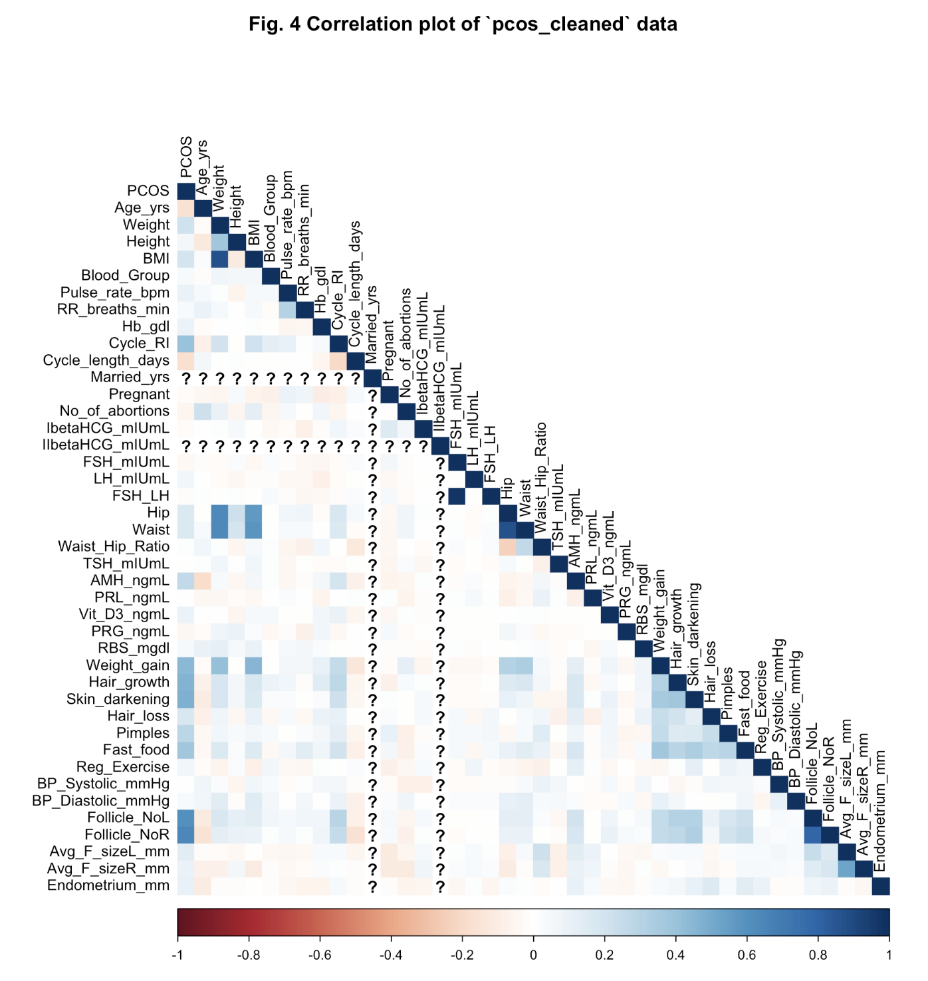
Experimentation and Results:
Correlation Plot
Positive correlations between: BMI and Weight, Weight_gain, Hair_growth, Skin_darkening and PCOS and Follicle_NoL, Follicle_NoR, and PCOS to name a few.
Negative correlations between: Waist_Hip_Ratio and Hip, AMH_ngmL and Age_yrs, and Follicle_NoR, Follicle_NoL and Age_yrs.
Notes:
Once the data was cleaned, I was able to create new plots to get a better picture of the data I was handling. One of these plots was a correlation plot. Based on my findings, there are not many variables that exhibit a notably strong positive or negative correlation, although some variables do fall within these categories to some extent.
For instance,
Positive correlations between: BMI and Weight, Weight_gain, Hair_growth, Skin_darkening and PCOS and Follicle_NoL, Follicle_NoR, and PCOS to name a few.
Negativecorrelationsbetween:Waist_Hip_RatioandHip,AMH_ngmLandAge_yrs,andFollicle_NoR, Follicle_NoL and Age_yrs.

Slide 15
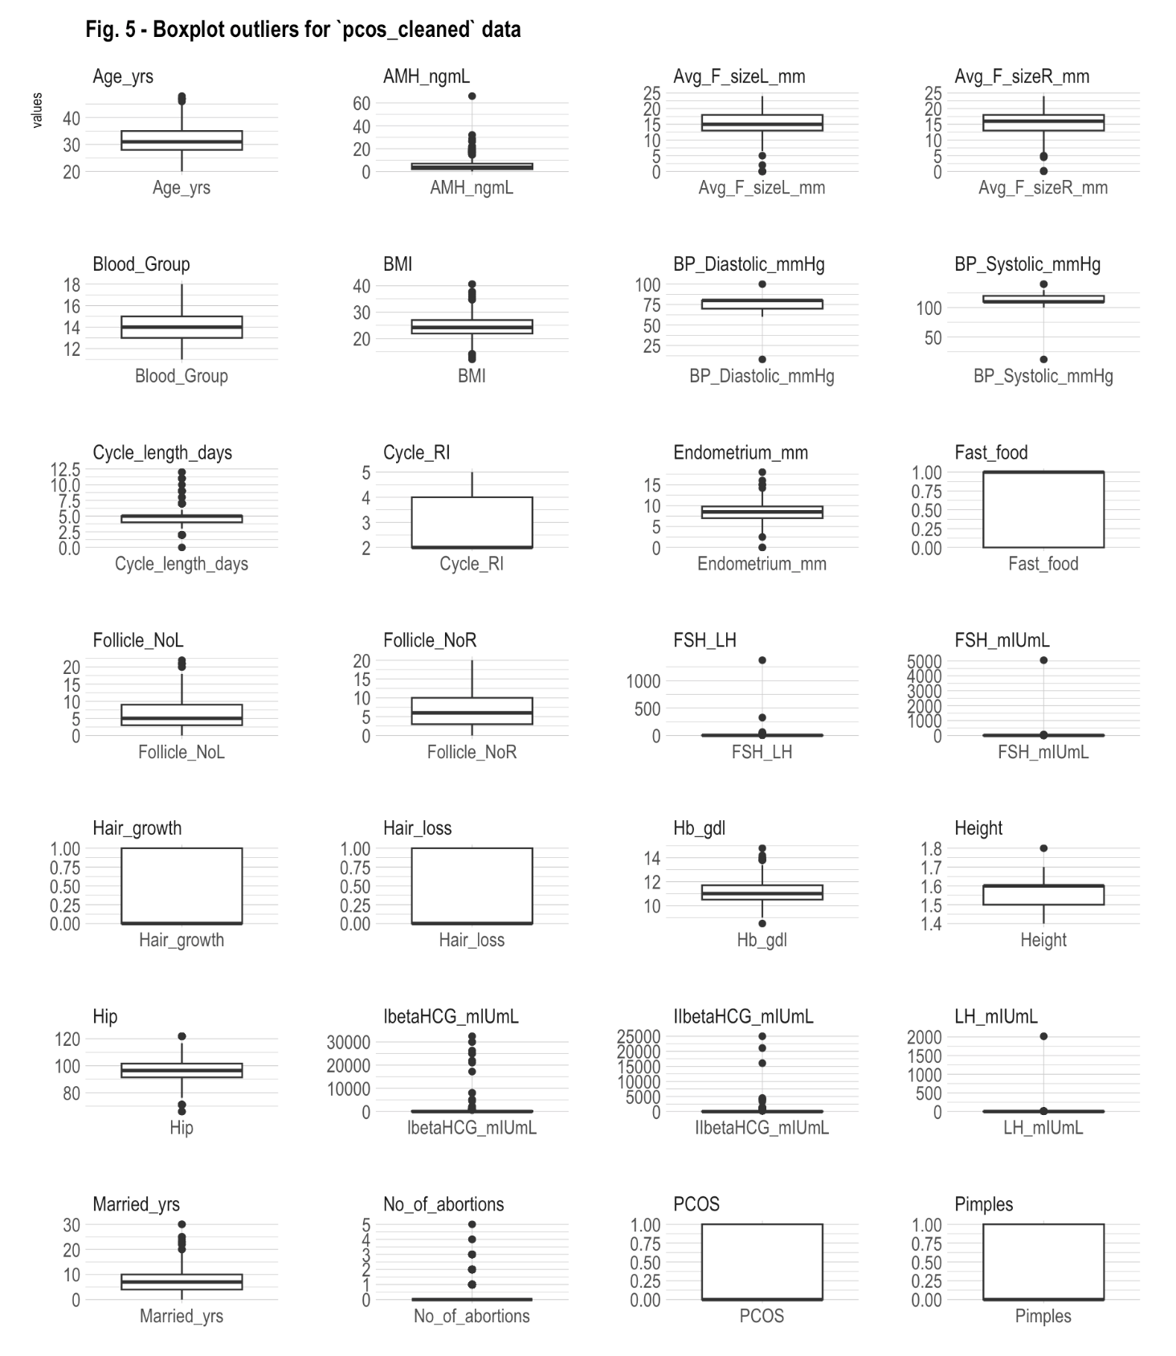
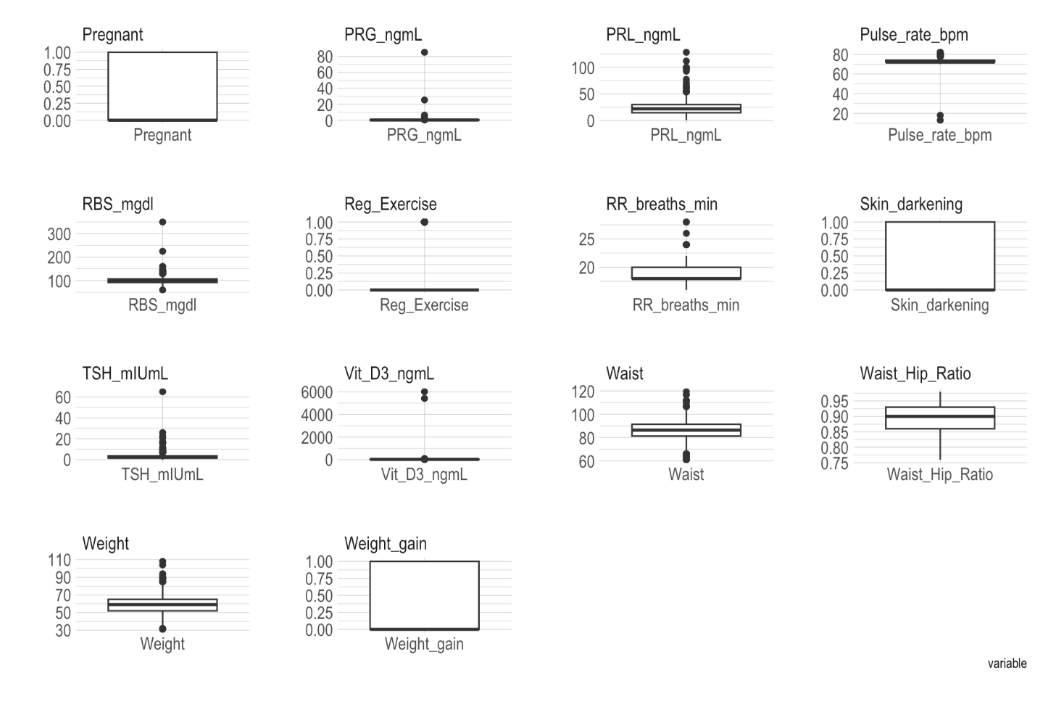
Boxplots:
Variables that included outliers were mainly hormonal markers such as: AMH_ngml, Endometrium_mm, FSH_LH, FSH_mIUmL, Hb_gdl, IbetaHCG_mIUmL, IIbetaHCG_mIUmL, LH_mIUmL, PRL_ngml, and TSH_mgdl.
Considering the dataset’s relatively small size, I’ve chosen to retain these outliers to ensure the inclusion of every individual data point as it represents natural variations in the population.
Notes:
With the help of boxplots we can identify outliers across a complete dataset. According to the visualizations provided, a handful of outliers are evident. Variables that included outliers were mainly hormonal markers such as: Egg count, Endometrium, FSH_LH, FSH_mIUmL, Hemoglobin concentration, both pregnancy hormones, LH_mIUmL, Prolactin, and thyroid hormone. Considering the dataset’s relatively small size, I’ve chosen to retain these outliers to ensure the inclusion of every individual data point as it represents natural variations in the population.

Slide 16
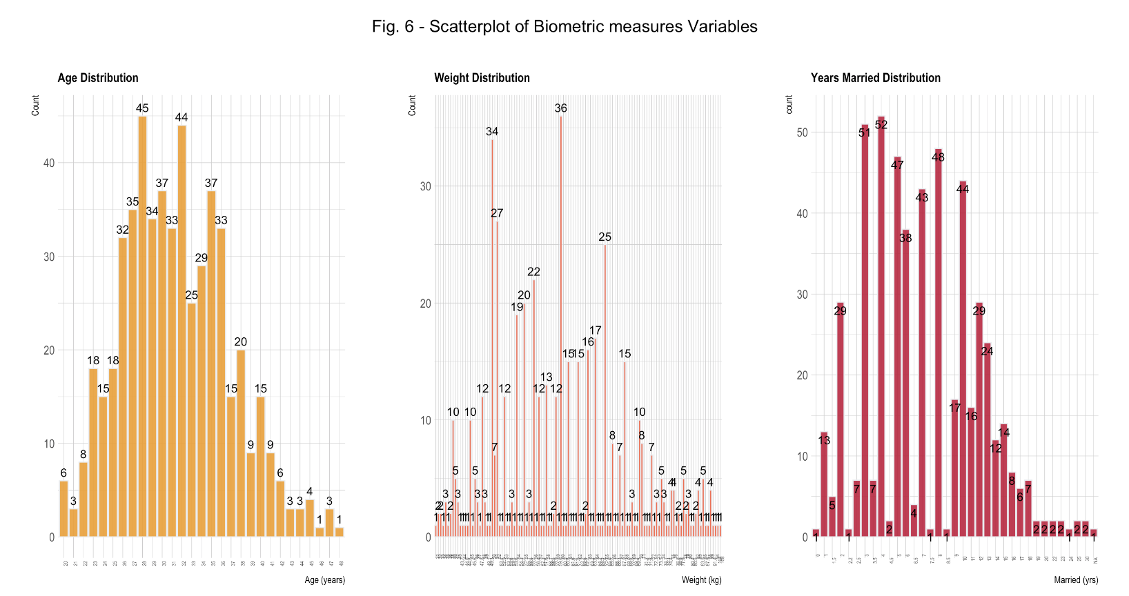
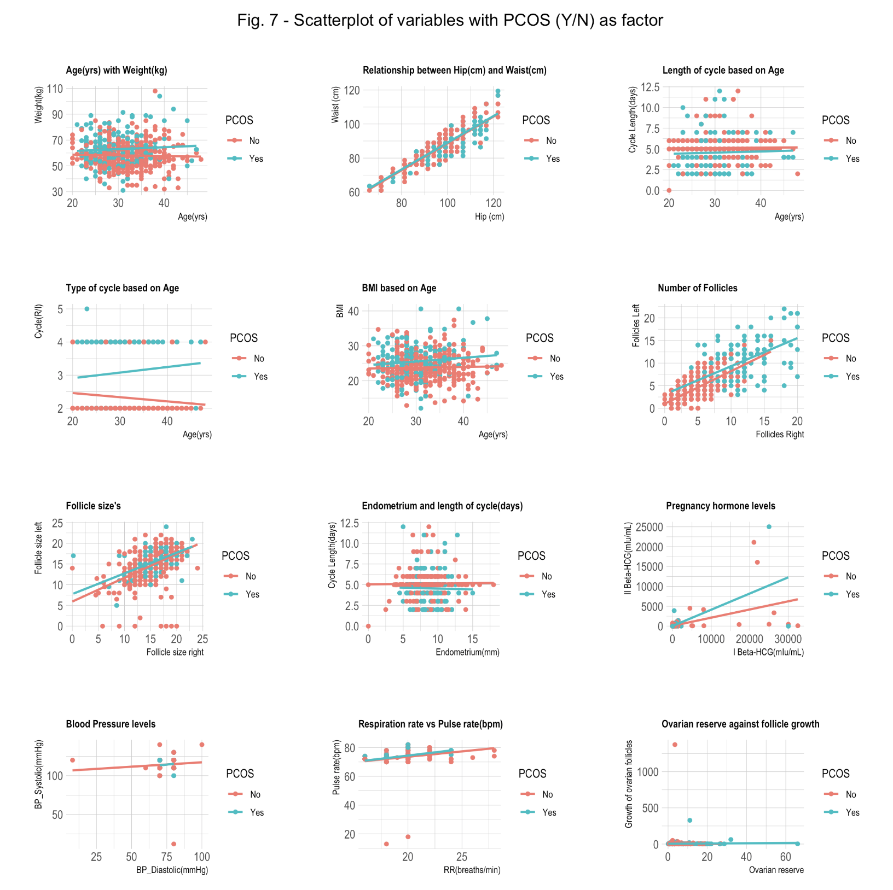
Data Exploration on `pcos_cleaned`
Fig. 6 - Scatterplot of Biometric Measures
Fig. 7 - Scatterplot of Variables with PCOS (Y/N) as factor
Notes:
Further visualizations was created with the clean dataset; Some key take aways are seen on screen:
There is a wide range of distribution between the age of these women most falling between 23 to 38 years old. Similarly, weight also has a wide range of distribution.
Most of the women in this study are between 1.5 - 1.6 meters tall (4’9” - 5’2”).
The distribution of years married also varies where the majority of the women fall between the first 10 years.
Cycle length seems to be very consistent regardless of PCOS diagnosis.
With or without PCOS women’s BMI fluctuates in women of all ages.
The variance in endometrial thickness between women with PCOS (thinner) and those without PCOS (thicker) evolves as the menstrual cycle progresses. This discrepancy arises due to hormonal imbalances. In women affected by PCOS, the absence of regular menstrual cycles leads to an unaltered endometrial lining, contrasting with the changes observed in women without the condition.
Blood pressure levels, Pulse rate and Respiration rate for women with and without PCOS are in normal range.

Slide 17
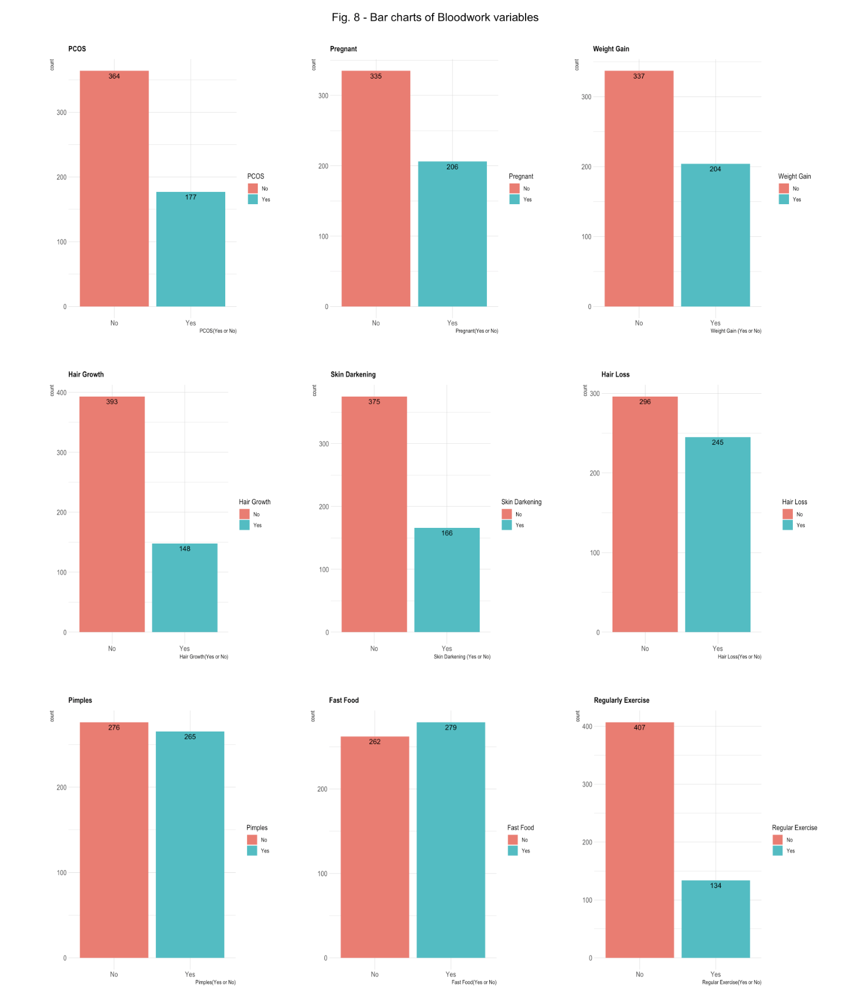
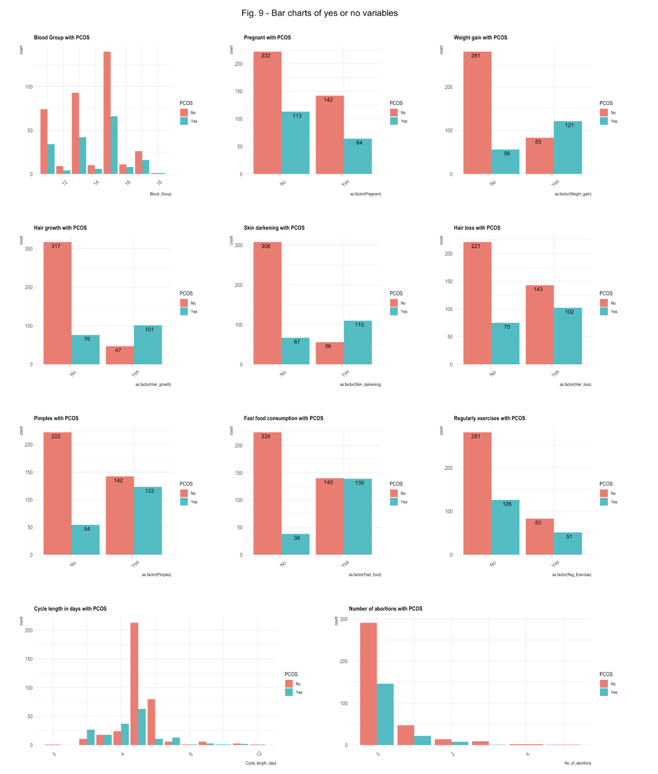
Barcharts:
Fig. 8 – Barcharts of Biometric Variables
Fig. 9 – Barcharts of variables with yes or no variables
Notes:
Out of 541 women:
32.72% reported to have PCOS
37.71% reported to experience weight gain and 22.37% of women reported to experience weight gain having PCOS.
45.29% reported to experience hair loss and 18.85% of women reported to experience hair loss with PCOS.
Women possessing blood types A+, B+, and O+ reported a higher incidence of PCOS compared to those with blood types A-, B-, O-, AB+, and AB-.
Being that PCOS and infertility are linked, there are 11.83% of women who reported to being pregnant with PCOS.

Slide 18
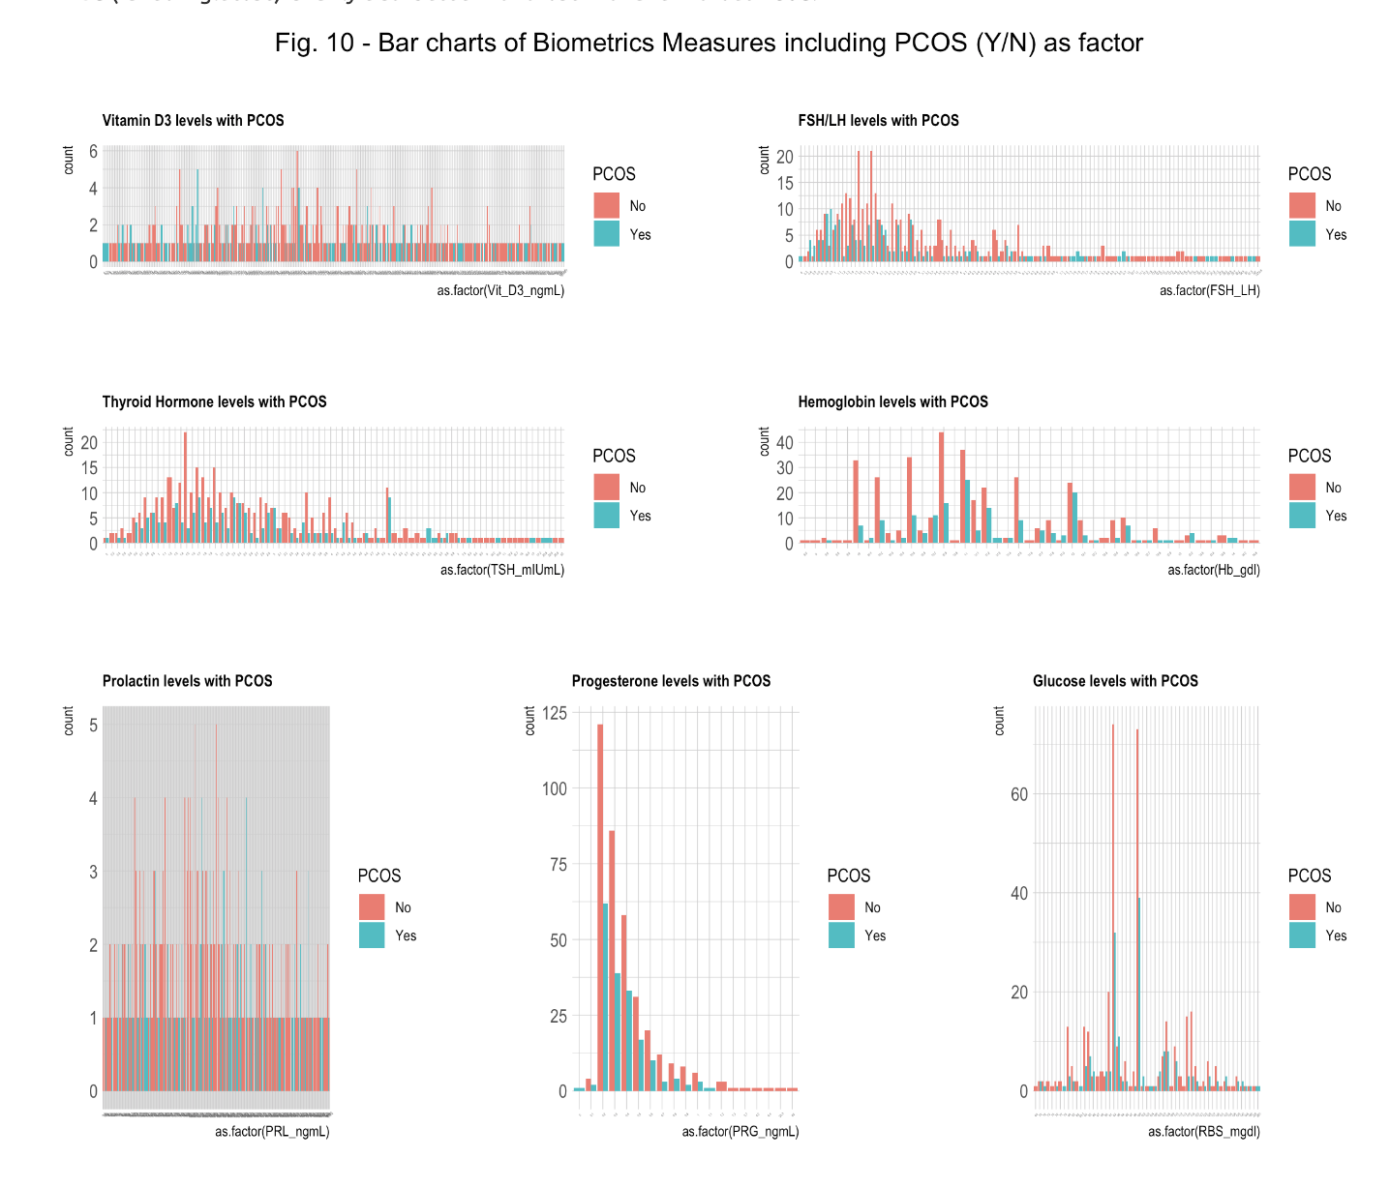
Last of the visualizations:
• Vitamin D3 levels are spread out for those who reported with or without PCOS.
• FSH/LH levels are right skewed for those who reported with or without PCOS.
• TSH levels are also spread out for women who reported to have PCOS and those who don’t.
• Hemoglobin levels seem to be higher for those who reported to have PCOS.
• PRL levels (prolactin in the blood) are consistent at 1 or 2 for those with or without PCOS.
• RBS (random glucose) is fairly distributed with those with and without PCOS.

Slide 19
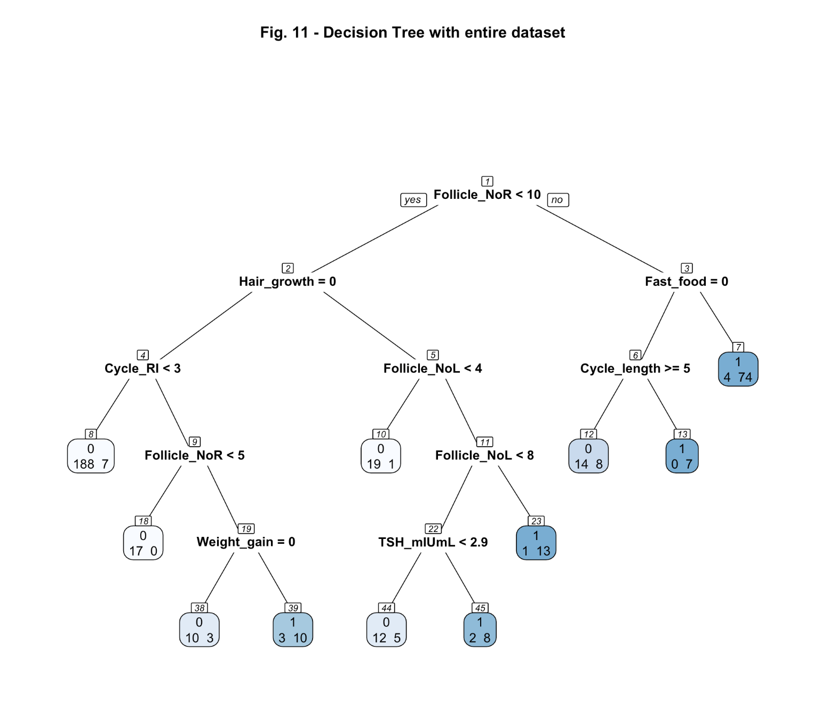
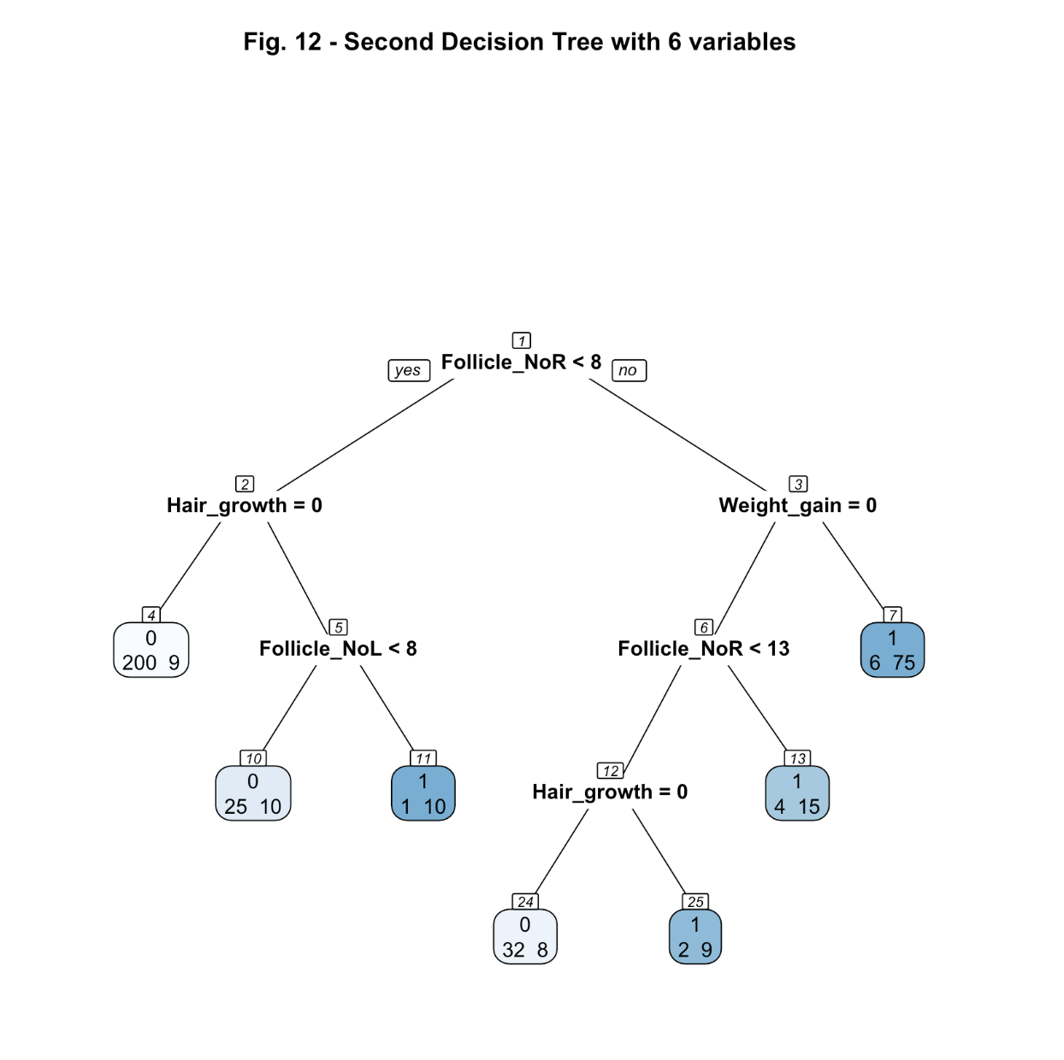
Model Building: Decision Tree
Fig. 11 - Decision Tree 1 was run against the whole dataset and yield an accuracy of 85.93%
Fig. 12 - Decision Tree 2 was run against the 6 most influential variables and yield and accuracy of 91.85%
Notes:
The model building involved the creation of 6 algorithms: Decision Tree (rpart), Ran- dom Forest (randomForest), Gradient Boosting Machines (xgboost or gbm), Support Vector Machines (e1071), Neural Networks (neuralnet), and K-Nearest Neighbors (kknn or class). For each algorithm, two models were generated. The first model was developed using the entire dataset with the target variable PCOS, while the second models were established using only the most influential variables, Follicle_NoL, Follicle_NoR, Hair_growth, Skin_darkening, Weight_gain and the target variable PCOS.

Slide 20
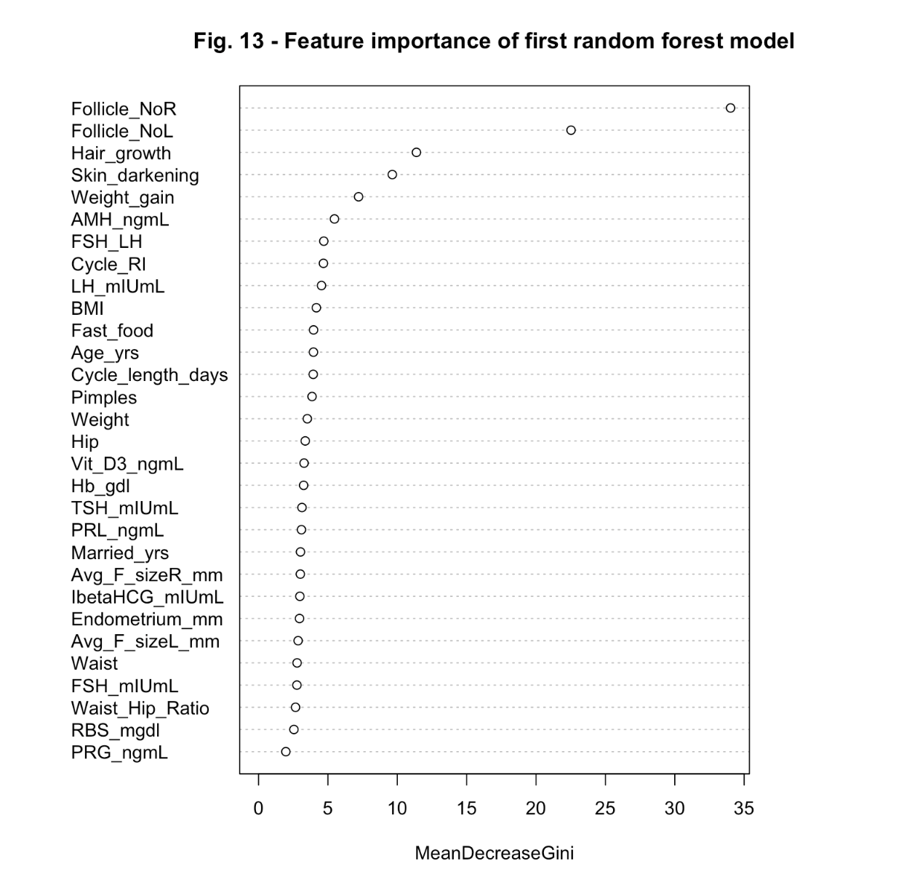
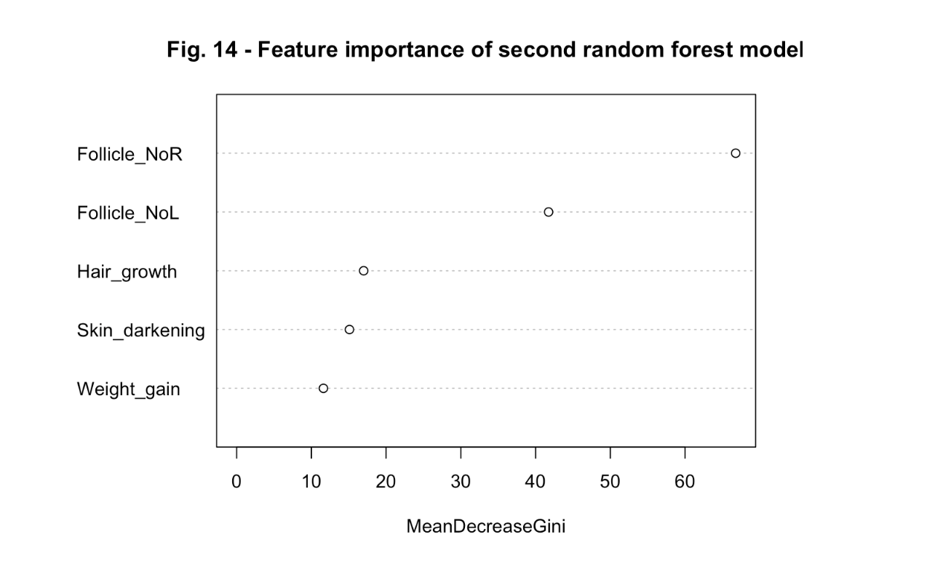
Model Building: Random Forest
Fig. 13 - Random Forest 1 was run against the whole dataset and yield an accuracy of 62.96%
Fig. 14 - Random Forest 2 was run against the 6 most influential variables and yield and accuracy of 90.37%
Notes:
The model building involved the creation of 6 algorithms: Decision Tree (rpart), Ran- dom Forest (randomForest), Gradient Boosting Machines (xgboost or gbm), Support Vector Machines (e1071), Neural Networks (neuralnet), and K-Nearest Neighbors (kknn or class). For each algorithm, two models were generated. The first model was developed using the entire dataset with the target variable PCOS, while the second models were established using only the most influential variables, Follicle_NoL, Follicle_NoR, Hair_growth, Skin_darkening, Weight_gain and the target variable PCOS.

Slide 21
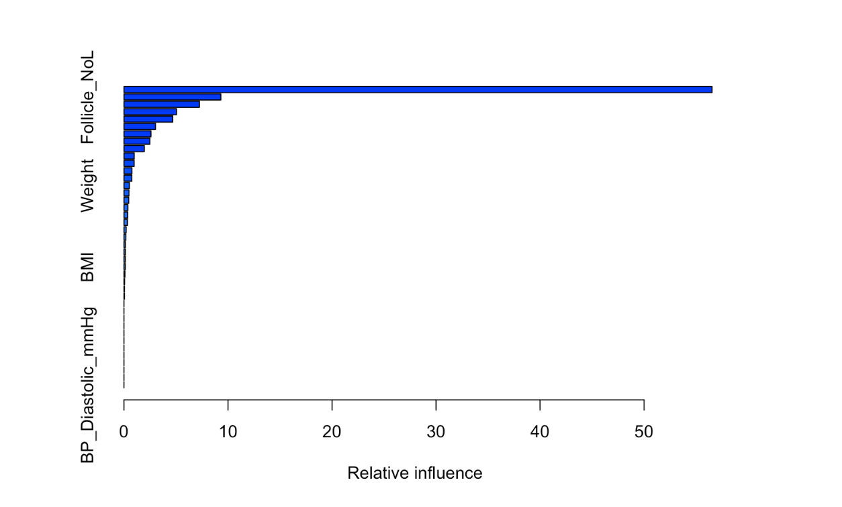
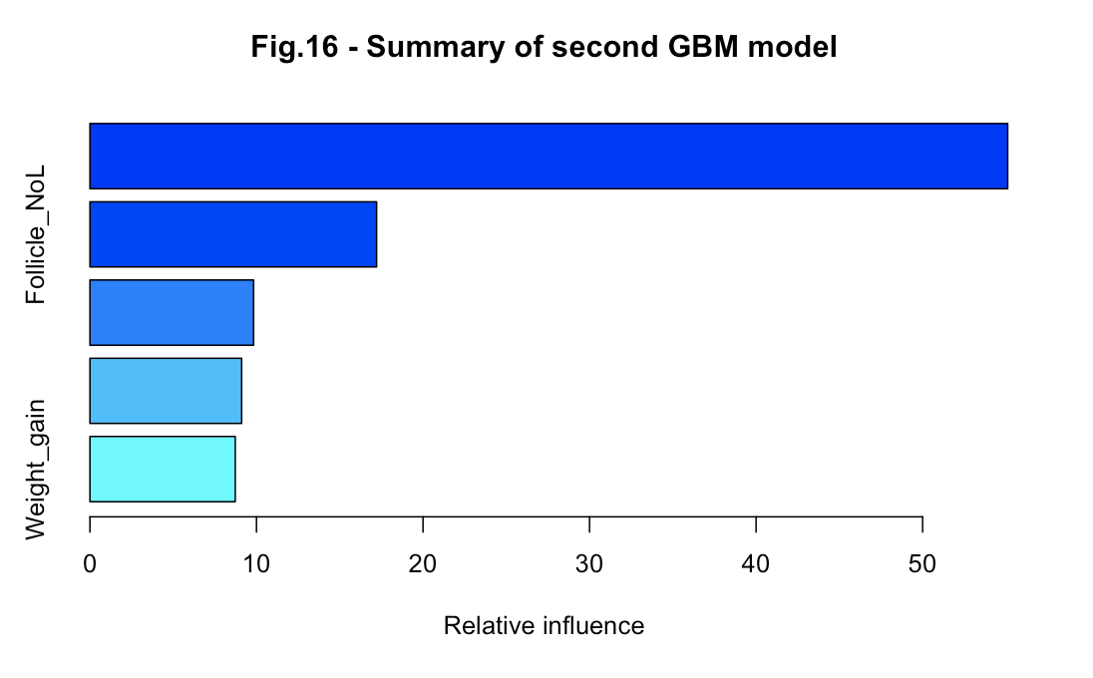
Model Building: Gradient Boosting Machines
Fig. 15 - Random Forest 1 was run against the whole dataset and yield an accuracy of 62.96%
Fig. 16 - Random Forest 2 was run against the 6 most influential variables and yield and accuracy of 90.37%
Notes:
The model building involved the creation of 6 algorithms: Decision Tree (rpart), Ran- dom Forest (randomForest), Gradient Boosting Machines (xgboost or gbm), Support Vector Machines (e1071), Neural Networks (neuralnet), and K-Nearest Neighbors (kknn or class). For each algorithm, two models were generated. The first model was developed using the entire dataset with the target variable PCOS, while the second models were established using only the most influential variables, Follicle_NoL, Follicle_NoR, Hair_growth, Skin_darkening, Weight_gain and the target variable PCOS.

Slide 22
Model Building: Support Vector Machines
SVM 1 was run against the whole dataset and yield an accuracy of 91.11%
SVM 2 was run against the 6 most influential variables and yield and accuracy of 91.85%
Notes:
The model building involved the creation of 6 algorithms: Decision Tree (rpart), Ran- dom Forest (randomForest), Gradient Boosting Machines (xgboost or gbm), Support Vector Machines (e1071), Neural Networks (neuralnet), and K-Nearest Neighbors (kknn or class). For each algorithm, two models were generated. The first model was developed using the entire dataset with the target variable PCOS, while the second models were established using only the most influential variables, Follicle_NoL, Follicle_NoR, Hair_growth, Skin_darkening, Weight_gain and the target variable PCOS.

Slide 23
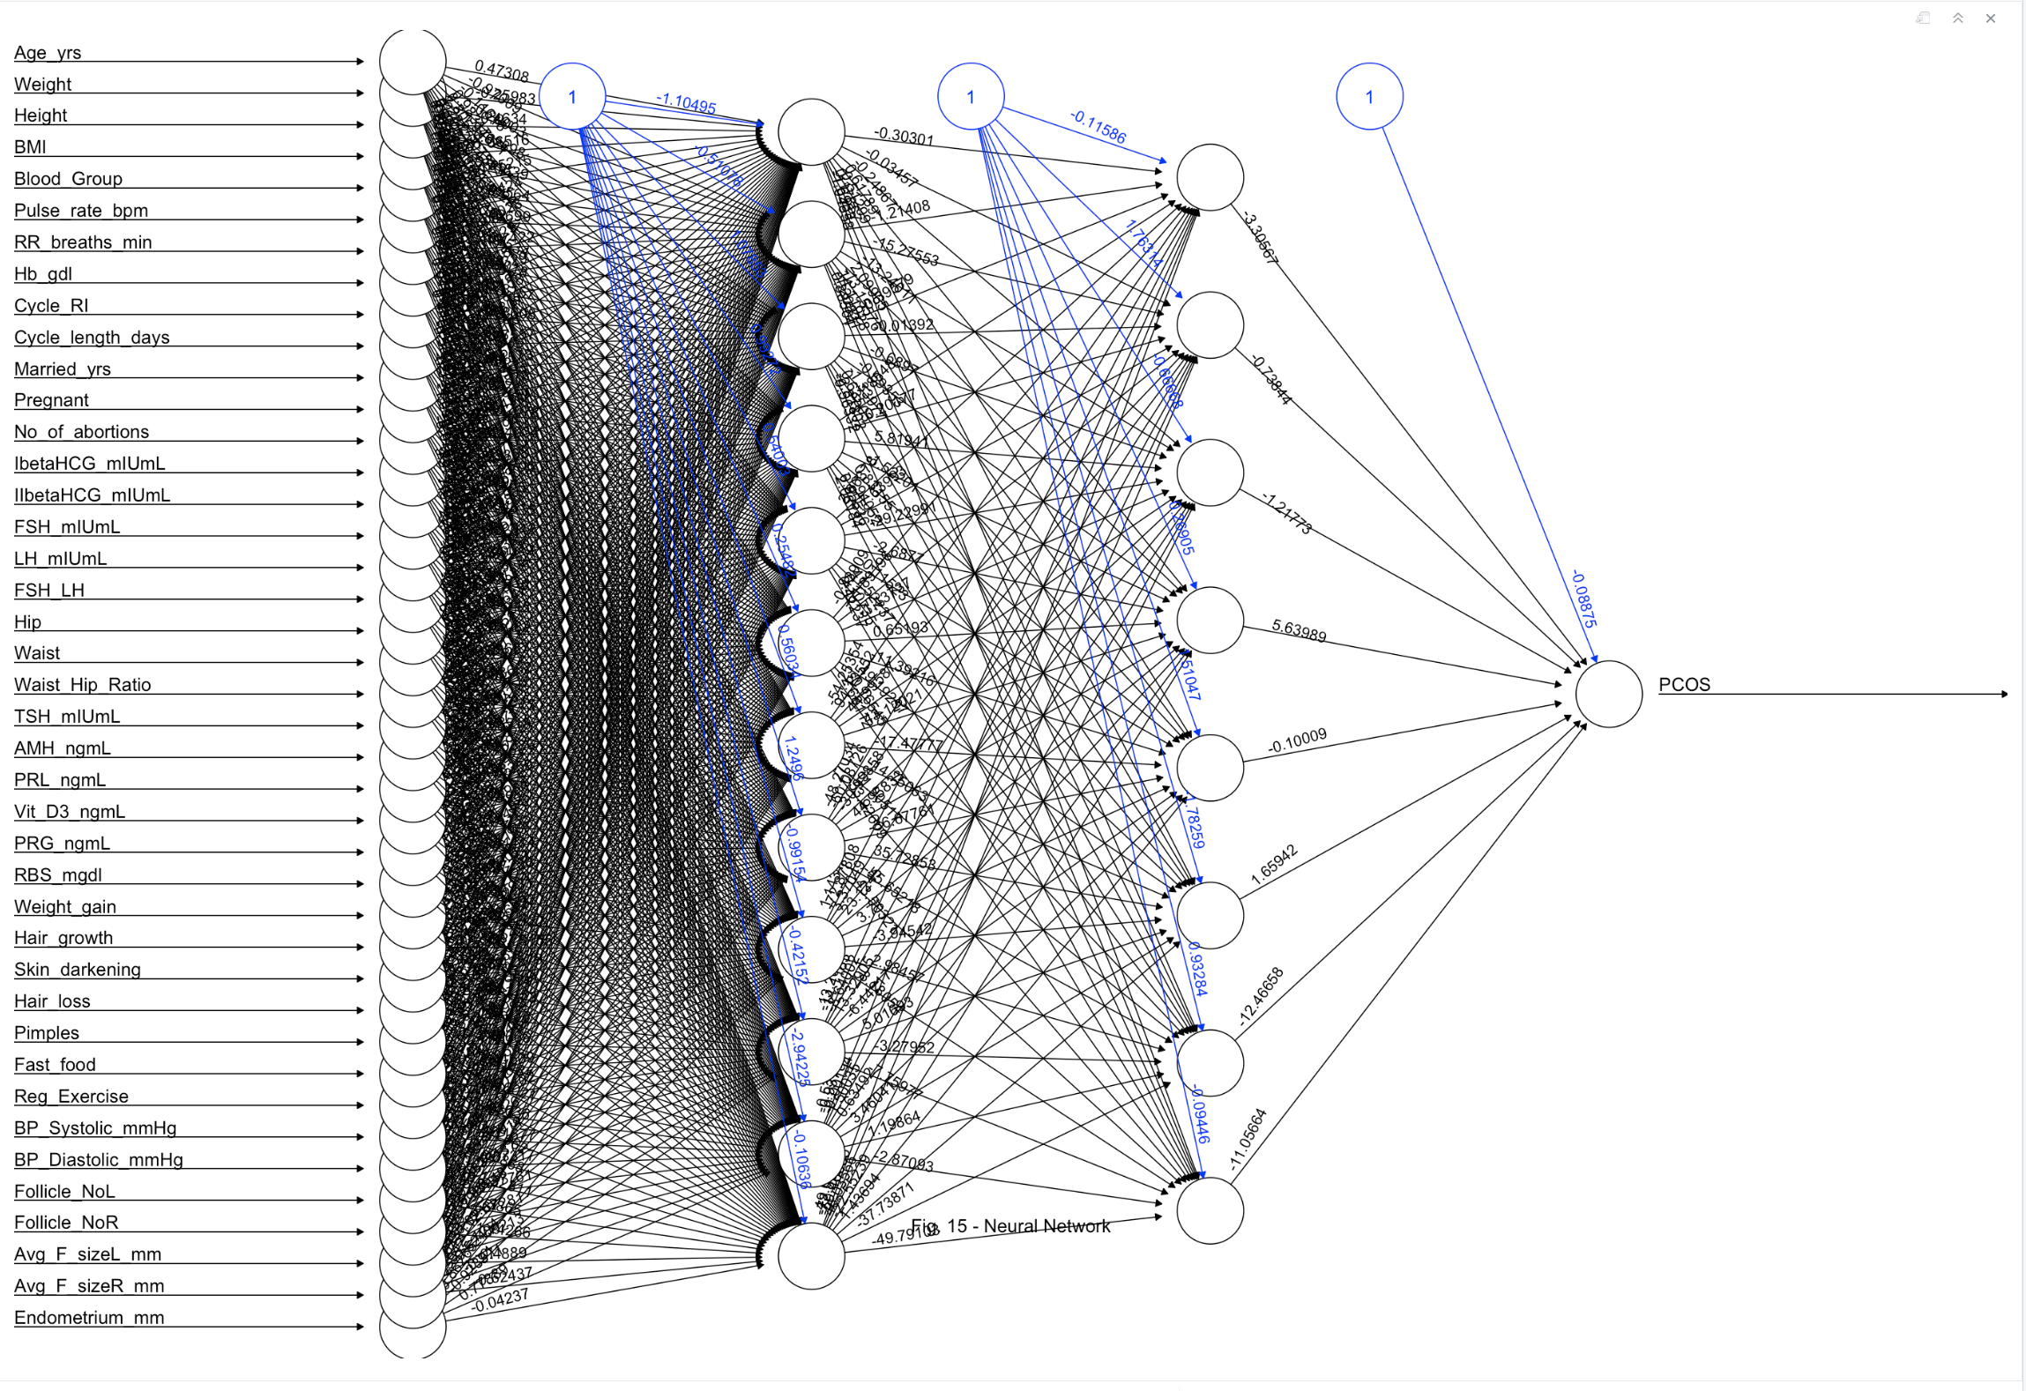
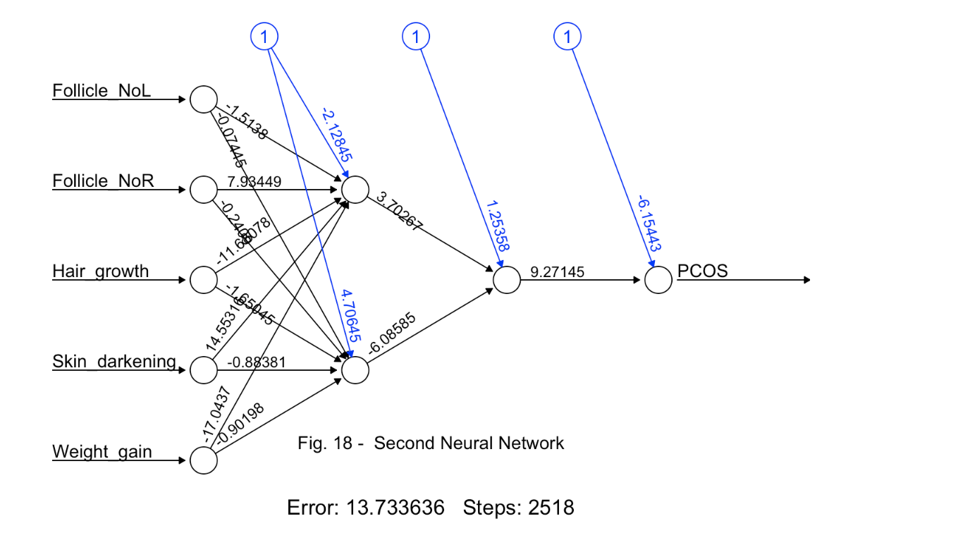
Model Building: Neural Networks
Fig. 17 – Neural Networks 1 was run against the whole dataset and yield an accuracy of 30.37%
Fig. 18 - Neural Networks 2 was run against the 6 most influential variables and yield and accuracy of 30.37 %
Notes:
The model building involved the creation of 6 algorithms: Decision Tree (rpart), Ran- dom Forest (randomForest), Gradient Boosting Machines (xgboost or gbm), Support Vector Machines (e1071), Neural Networks (neuralnet), and K-Nearest Neighbors (kknn or class). For each algorithm, two models were generated. The first model was developed using the entire dataset with the target variable PCOS, while the second models were established using only the most influential variables, Follicle_NoL, Follicle_NoR, Hair_growth, Skin_darkening, Weight_gain and the target variable PCOS.

Slide 24
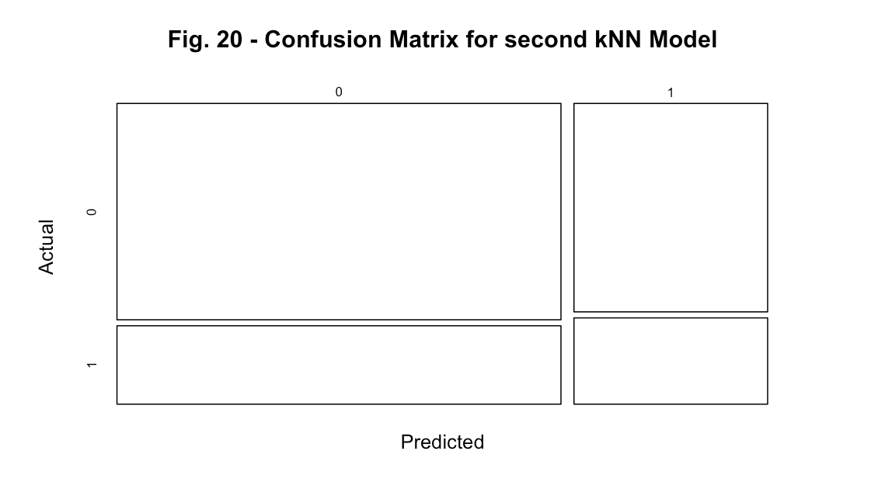
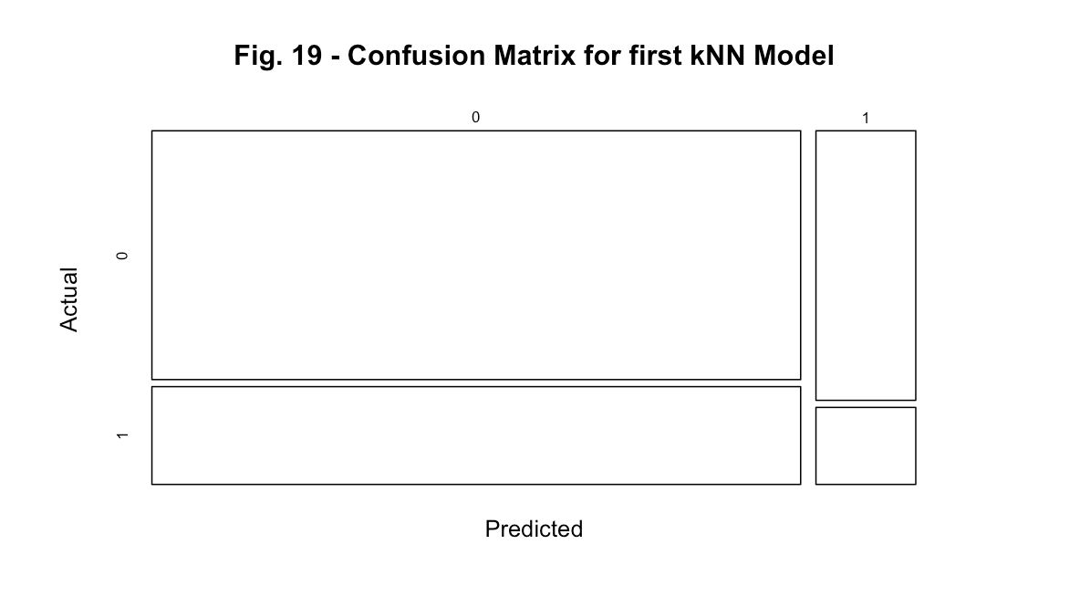
Model Building: K-Nearest Neighbors
Fig. 19 – k-Nearest Neighbor 1 was run against the whole dataset and yield an accuracy of 65.19%
Fig. 20 - k-Nearest Neighbor 2 was run against the 6 most influential variables and yield and accuracy of 88.15%
Notes:
The model building involved the creation of 6 algorithms: Decision Tree (rpart), Ran- dom Forest (randomForest), Gradient Boosting Machines (xgboost or gbm), Support Vector Machines (e1071), Neural Networks (neuralnet), and K-Nearest Neighbors (kknn or class). For each algorithm, two models were generated. The first model was developed using the entire dataset with the target variable PCOS, while the second models were established using only the most influential variables, Follicle_NoL, Follicle_NoR, Hair_growth, Skin_darkening, Weight_gain and the target variable PCOS.

Slide 25
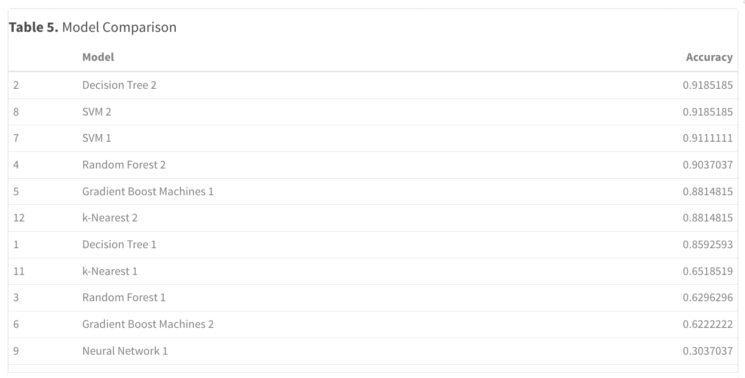
Conclusion:
Top 5 models with the highest accuracies were:
Model 2: Decision Tree 2
Model 7 and 8: SVM2 and SVM 1
Model 3: Random Forest 2,
Model 5: Gradient Boost Machine 1.
Notes:
Both Decision Tree 2 and SVM 2 achieved similar high accuracies of approximately 91.85%. This implies that these models were quite successful in making accurate predictions for PCOS diagnosis based on the given data and features. SVM 1 achieved a slightly lower accuracy compared to Decision Tree 2 and SVM 2 but still performed reasonably well at approximately 91.11%. It remains effective in predicting PCOS diagnosis but might be slightly less accurate than the aforementioned models. The second Random Forest model achieved an accuracy of around 90.37%, indicating its capability to correctly classify PCOS and non- PCOS cases with slightly less accuracy than SVM 1 and Decision Tree 2. Both Gradient Boost Machines 1 and k-Nearest 2 models obtained accuracies around 88.15%, which, while lower than the previous models, still demonstrate a moderate ability to predict PCOS diagnosis based on the provided features.
Overall, these accuracies suggest that Decision Tree 2, SVM 2, SVM 1, and Random Forest 2 performed relatively better in distinguishing between PCOS and non-PCOS cases in this dataset, while Gradient Boost Machines 1 and k-Nearest 2 showed somewhat lower but still reasonably acceptable prediction accuracies.
Initially, I presumed that due to the scarcity of information within the medical domain and the limited availability of datasets for analysis, I held reservations about the potential success in accurately predicting a PCOS diagnosis. Surprisingly, 8 out of the 12 models developed exhibited accuracies surpassing 85%, with only 4 out of the 8 achieving an accuracy exceeding 90%. In comparison to the findings in existing literature utilizing the same Kaggle dataset, the top 5 algorithms I employed showed a slightly lower performance, where these achieved accuracies above 95%. If I had to pick an algorithm to best represent my dataset I’d select SVM 1 as its accuracy was of 91.11%, a unique percentage not replicated by other algorithms. Conversely, the utilization of Neural Networks in this analysis did not yield satisfactory results, deviating from the expectations set by the literature. This outcome might be attributed to the specific package utilized and the parameter settings chosen for the neural network model. For the future work, I aim to explore datasets such as NICHDash which are not publicly available and feature a slightly larger and more diverse population within the United States. This exploration will facilitate a more comprehensive assessment of PCOS, enabling a deeper understanding of the condition’s nuances and complexities.
Having subjected the data to various algorithms, I am now able to address the anticipated questions: 1. Are there commonalities women with and without PCOS have that can be easily dismissed as normal?
17
• Some shared patterns identified through analysis included Body Mass Index (BMI), vital signs, bio- metric measurements, and specific hormone levels, yet within this dataset, insuﬀicient evidence exists to conclusively dismiss these as unrelated to Polycystic Ovary Syndrome (PCOS).
2. Are there differences for women of different race/ethnic background when it comes to having PCOS? What about women without PCOS?
• These accuracies don’t directly address racial or ethnic differences as the dataset only involved women from Kerala, India. Further analysis involving feature exploration or specific subgroup analysis using demographic data might unveil associations or variations among different racial/ethnic groups in PCOS prevalence or features.
3. What is the likelihood of a woman developing PCOS based on her age, ethnicity, and BMI history?
• The accuracies did not explicitly signify predictions regarding probability due to the lack of diverse ethnic backgrounds in the collected records. Moreover, age and BMI were not influential variables across most of the created models in this dataset. Specific models with feature importance or coeﬀicients might offer insights into how age, ethnicity, and BMI contribute to predicting PCOS likelihood but the data would have to include such diversity.
4. Can we predict the risk of insulin resistance, diabetes, and cardiovascular disease in women with PCOS based on their medical history, hormone levels, and lifestyle factors?
• Machine learning models could help predict the risk of insulin resistance, diabetes, and cardiovascular disease in women with PCOS based on available medical history, hormone levels, and lifestyle factors. For this a larger dataset would be needed in order to create specialized modeling to derive precise predictions. Regrettably, my dataset would not be well-suited for conducting such forecasts.
5. Can we predict the likelihood of successful pregnancy outcomes in women with PCOS based on their age, weight, hormone levels, and treatment history?
• Similar to the above, machine learning models can potentially predict the likelihood of successful pregnancy outcomes in women with PCOS based on various factors like age, weight, hormone levels, and treatment history. A more expansive dataset, specialized models, or in-depth analyses could offer more intricate predictive insights, exceeding the capabilities of my current dataset.
6. Can we predict the long-term health outcomes and quality of life of women with PCOS based on their age, lifestyle factors, hormone levels, and treatment history?
• Machine learning models, when trained with extensive data including age, lifestyle factors, hormone levels, and treatment history, might offer predictive insights into long-term health outcomes and quality of life for women with PCOS. However, these models might need additional feature engineering and specialized analyses to offer accurate predictions. I expect that accurately predicting long-term health outcomes, despite an improved dataset, will remain challenging due to the varied presentation of PCOS in women, which poses ongoing diagnostic challenges.

Slide 26
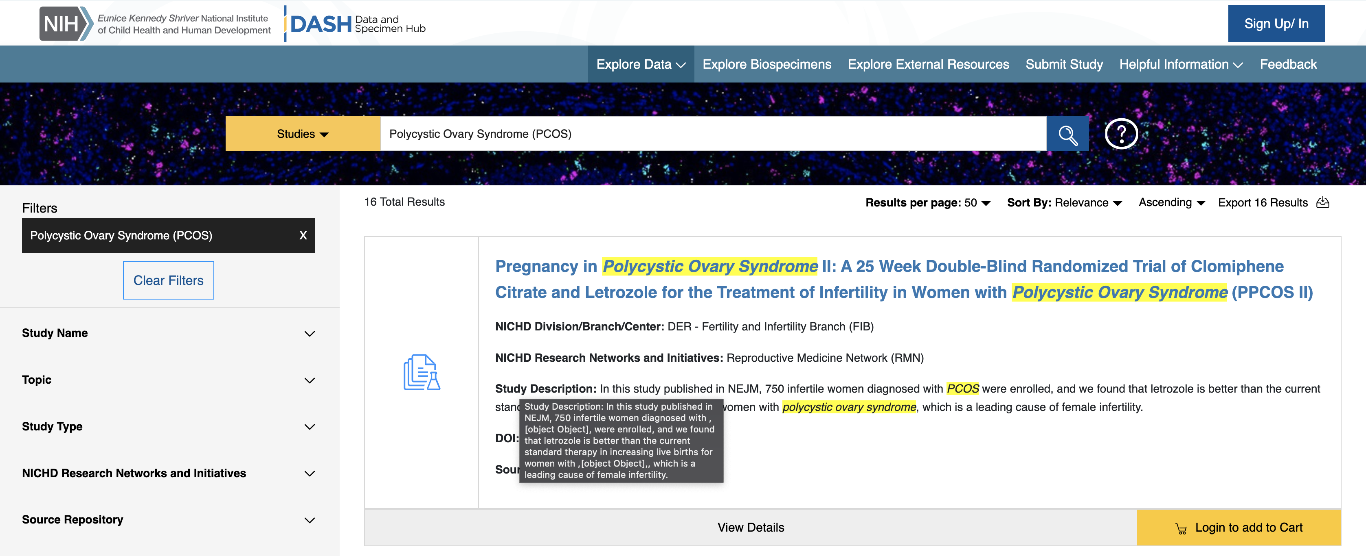

Future work
Explore datasets such as NICHDash
Dive into other machine learning algorithms
Learn more about SVM, NN and K-NN
Notes:
I aim to explore datasets such as NICHDash which are not publicly available and feature a slightly larger and more diverse population within the United States. This exploration will facilitate a more comprehensive assessment of PCOS, enabling a deeper understanding of the condition’s nuances and complexities.
I’d also like to explore other machine learning algorithms that were discussed in the literature reviews and practice more with SVM, NN and K-NN.

Slide 27




Thank you!
Code, References and more available in my GitHub

